Slide 1

Apartment Comparison Tool
Hayden Williford
Jack Callahan
Lillian Bowling
Matthew Rostar

Slide 2

Dataset
UC Irving Machine Learning Repository
100k Records of Apartments in the US
21 Variables
Variables of Interest
Title, Price, Amenities, Bedrooms, Bathrooms, Square Feet, City, Pets, Latitude and Longitude

Slide 3



Problem Statement
“Should I renew my lease at my current apartment? If not, what are similar options near me?”
Current websites require signing up, providing personal information and answering many questions
Only show apartments in your area based on some algorithm
Requires users to evaluate their current apartment on their own

Slide 4
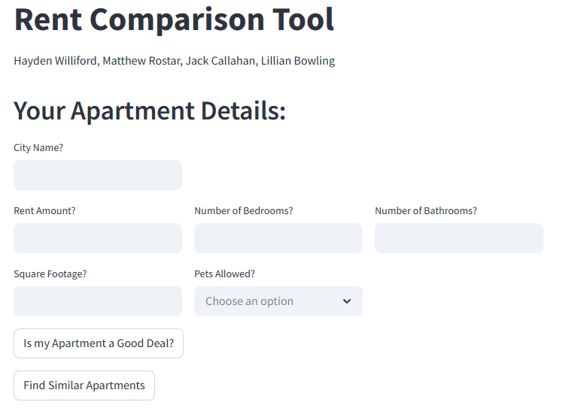

Slide 5
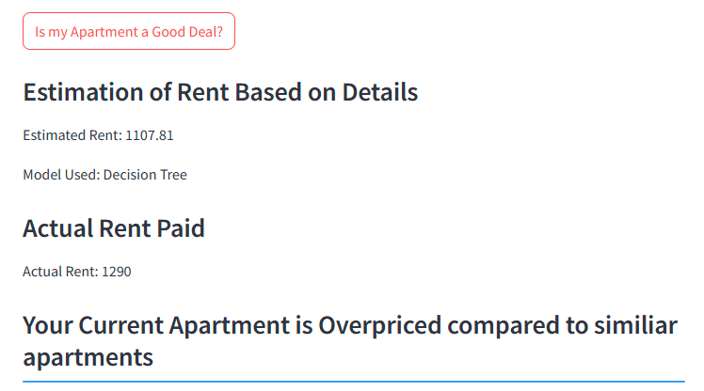

Slide 6
